Slide 1
CGB1201 – JAVA PROGRAMMING
Department of Artificial Intelligence And Data Science
Academic Year: 2024 – 2025 (Odd Semester)
Register Number : 2303811724321065
Name : Mithravasan VBH
Year : II
Semester : III
Section : B
Date : 25.11.2024

Slide 2
TITLE OF THE PROJECT
WORD COUNTER
Word Counter

Slide 3
Problem Identification
Trouble separating punctuation from words.
Confusion in counting words like "don't."
Treating "Word" and "word" as different.
Counting common words like "and" unnecessarily.
Issues with words like "mother-in-law."
Difficulty with non-English or complex languages.

Slide 4
Objective
The objective of the Word Counter App is to provide a simple, user-friendly tool that allows users to count the number of words in a given text. This application focuses on:
Accurate Word Counting: Ensuring the correct count of words in the input text, even with edge cases like extra spaces or punctuation.
Ease of Use: Offering an intuitive interface with clear labels and actions for all users.
Real-time Feedback: Displaying the word count dynamically upon user interaction.
Efficient Resource Usage: Implementing lightweight, responsive functionality suitable for a basic desktop application.
User Experience: Incorporating visually appealing design elements, such as readable fonts and pleasant color schemes.

Slide 5
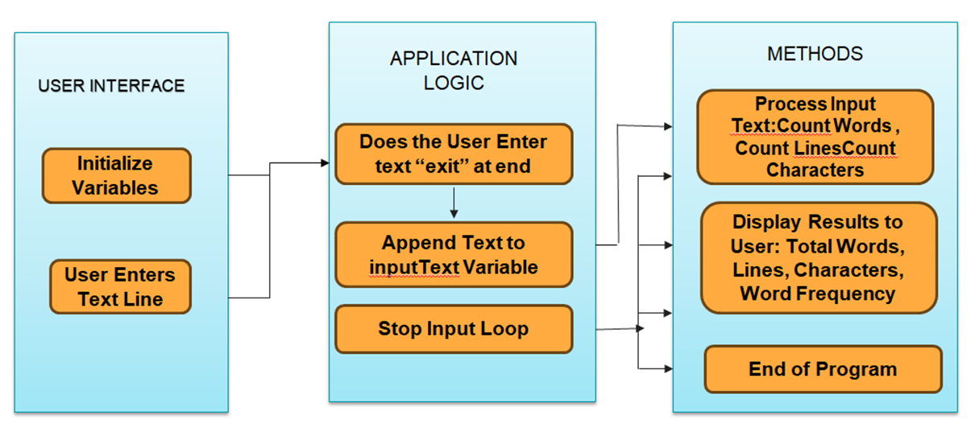
PROPOSED ARCHITECTURE

Slide 6
JAVA PROGRAMMING - CONCEPTS USED
Here are three simple Java programming concepts used in the Word Counter application:
AWT Components: The application uses components like Frame, TextArea, Button, and Label from the AWT library to create the graphical user interface.
Event Handling: Actions like button clicks are managed using ActionListener, allowing the application to perform the word count when the button is clicked.
String Manipulation: Methods like trim() and split() are used to process the input text by removing extra spaces and counting words accurately.

Slide 7
List of Modules
Word Count Calculation Module
Text Processing Module
User Interface Module
Input Validation Module
Display Module

Slide 8
MODULE DESCRIPTION
Word Count Calculation Module Description: Calculates the number of words in the input text. Features:
Splits the text into words based on spaces and punctuation.
Counts the total number of words in the input.
Handles edge cases like multiple spaces or punctuation between words.
Text Processing Module Description: Handles formatting and cleaning of the input text. Features:
Removes extra spaces before and after the text.
Trims unnecessary whitespace in the input.
Prepares the text for accurate word count calculation.

Slide 9
Module Description (Cont..)
User Interface Module Description: Provides the graphical interface for user interaction. Features:
Includes a text area for users to input text.
Provides a button to trigger the word count action.
Displays the calculated word count in an intuitive format.
Input Validation Module Description: Ensures that the input data is clean and valid for processing. Features:
Validates that the text input is not empty.
Checks for any invalid characters or formatting.
Alerts users if the input is invalid or empty.

Slide 10
Module Description (Cont..)
Display Module Description: Displays the results of the word count calculation to the user. Features:
Updates the user interface with the word count after calculation.
Provides a clear and readable display of the results.
Supports dynamic updates when text is changed or updated.

Slide 11
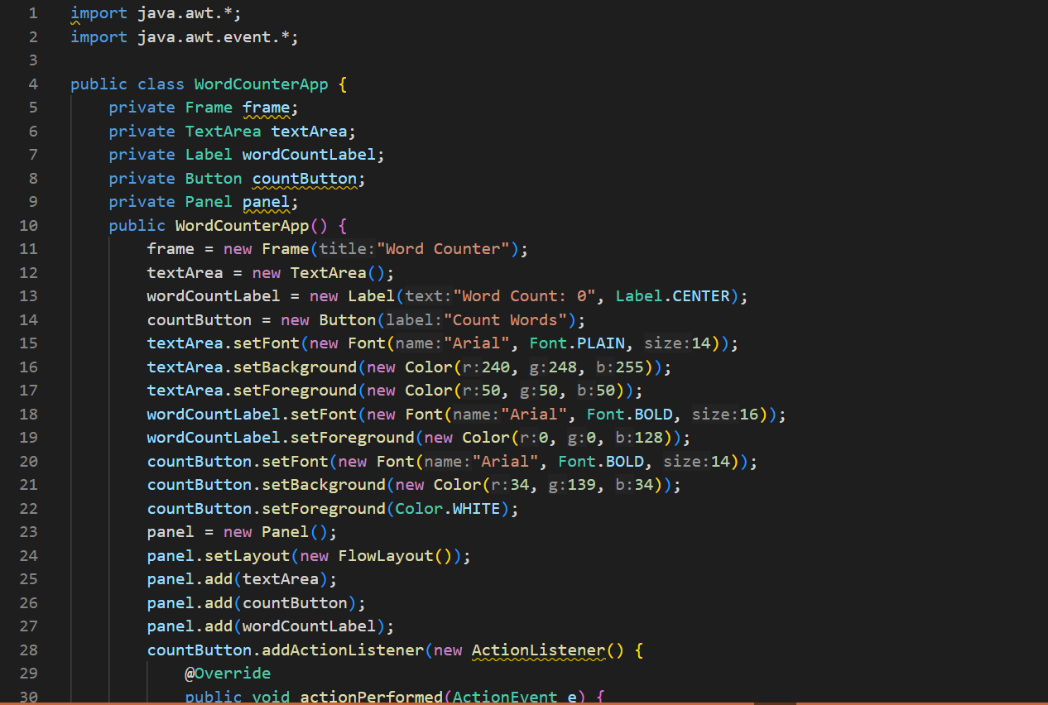
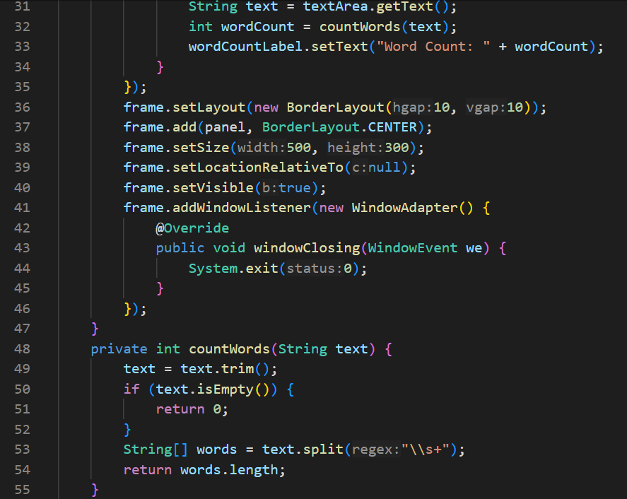
Source Code

Slide 12
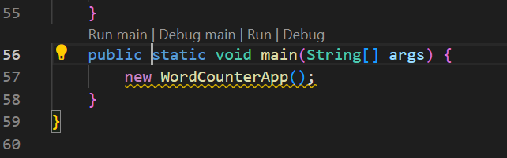
Source Code (Cont..)

Slide 13
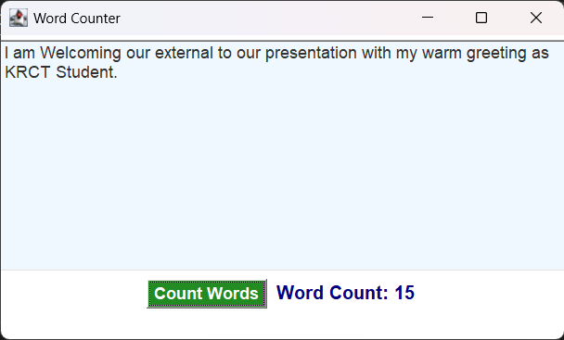
Results

Slide 14
CONCLUSION
word counters are valuable tools for analyzing text efficiently, but they come with certain challenges. Issues such as handling special characters, contractions, and stopwords can impact accuracy, while language diversity and differences in formatting styles further complicate their functionality.
Processing large files or datasets also poses performance concerns. However, with advancements in algorithms and natural language processing, these challenges can be addressed.
Enhancements like improved parsing, multilingual support, and better optimization will make word counters more accurate, reliable, and versatile tools for a variety of text analysis tasks.

Slide 15
Thank You
Any queries???

